Slide 1
Building a part of Watson

Slide 2
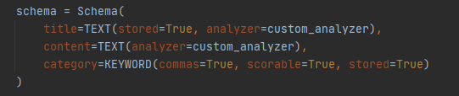
Indexing and Retrieval

Slide 3
Building the query
- the clue is preprocessed with the same analyzer as the content from the Wikipedia pages
- we use no synonyms, as it did not improve the results, but made them worse
- we use the category because it increases the search precision by providing additional context
- final form of the query: CLUE OR CATEGORY

Slide 4
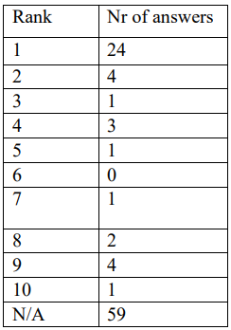
Measuring performance
The Mean Reciprocal Rank (MRR)
- suitable metric for systems that work with ranked lists and the relevance of an answer is binary
- measures the ability of a system to return relevant results
Results:
- for top 10: 0.688
- for top 100: 0.648
- for top 300.000: 0.512
If the answer is not in the top X, it is considered as 0 in the MRR formula.

Slide 5
Error analysis
Performance:
- answered correctly 24 questions, 76 wrong
Success of the system:
- the rich and structured nature of Wikipedia content
- techniques like lemmatization and the use of categories
- strategic implementation of the Whoosh index
Error categories:
- Similar but Incorrect: answers are related to the query, but not the answer
- Loss of Crucial Information Due to Preprocessing: certain techniques can strip essential context and details (“US” -> “U”)
- Contextual Misinterpretation: interpretation of the query does not capture the essence required

Slide 6
Improving retrieval
- Process: used the web interface of ChatGPT to rearrange the top 10 answers such that the first position contains the answer
- it is nondeterministic, given the behavior of ChatGPT
- on average, the score improved by ~0.1 in MRR measurement (5 trials)

Slide 7
Thank you for the attention!

